Slide 1
Functional Dependency (FD)
Introduction
Types of FDs

Slide 2
Definition
The functional dependency is a relationship that exists between two attributes. It typically exists between the primary key and non-key attribute within a table.
X → Y
The left side of FD is known as a determinant, the right side of the production is known as a dependent.

Slide 3
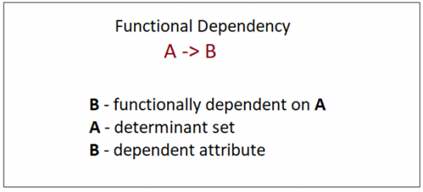
How to Denote a Functional Dependency in DBMS?
A functional dependency is denoted by an arrow “→”. The functional dependency of A on B is represented by A → B.

Slide 4
Example
Employee Table
Functional Dependencies are:
Employee_Id→ Employee_Name
Employee_Id→ Employee_Department
Employee_Id→ Salary
Employee_Id | Employee_Name | Employee_Department | Salary
1 | Ryan | Mechanical | $5000
2 | Justin | Biotechnology | $5000
3 | Andrew | Computer Science | $8000
4 | Felix | Human Resource | $10000

Slide 5
FD: Examples
1. Student
2. Student
Sid | Sname
101 | Amit
102 | Amita
103 | Sumit
102 | Amita
Sid | Sname
101 | Amit
101 | Amit
102 | Shubham
103 | Rahul
Sid→ Sname
Valid FD
Sid→ Sname
If, t1.X=t2.X
Then, t1.y-t2.y
Valid FD

Slide 6
FD: Examples
3. Student
4. Student
Sid | Sname
201 | Geeta
201 | Anna
202 | Seema
203 | Seema
Sid | Sname
111 | Ankit
111 | Ankit
123 | Sam
123 | Shyam
Sid→ Sname
Invalid FD
Sid→ Sname
Invalid FD
Reason: Sid 201 is having two different values of Sname, which is not allowed.
Reason: Sid 123 is having two different values of Sname, which is not allowed.

Slide 7
Types of Functional dependency
1. Functional Dependency
A functional dependency is a constraint that specifies the relationship between two sets of attributes where one set can accurately determine the values of other sets. It is denoted by X→Y, where X is determinant and Y is dependent.
EmpId | Empname | Empage
E101 | Amit | 20
E102 | Sumit | 30
EmpId→ Empname

Slide 8
Set and Proper Subset
Set A is considered to be a proper subset of Set B if Set B contains at least one element that is not present in Set A.
Example: If set A has elements as {12, 24} and set B has elements as {12, 24, 36}, then set A is the proper subset of B because 36 is not present in the set A.

Slide 9
2. Fully Functionally Dependency (FFD)
An attribute is fully functional dependent on another attribute, if it is functionally dependent on that attribute and not on any of its proper subset.
EmpId | ProjectID | ProjectCost | Days
E101 | P201 | 100 | 1000
E102 | P202 | 150 | 2000
EmpId,ProjectId,ProjectCost→Days

Slide 10
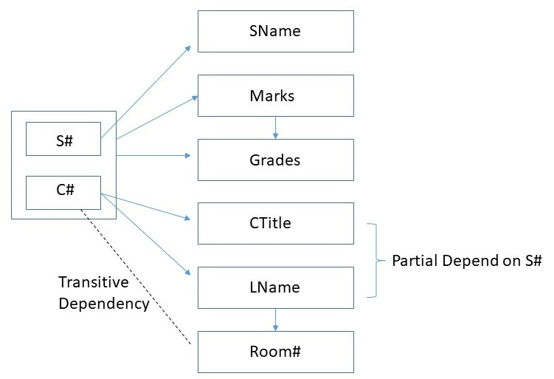
FFD Example
As per the FFD definition:
Here in relation R having attribute X,Y and X is a composite attribute(S#, C#) and Y attribute is {Marks}.
The subset of X composite attribute {S#},{C#} alone not functionally determine
Y attribute(Marks)

Slide 11
Marks is fully functional dependent on S#, C# and not a subset of S#, C#
This means Marks can’t be determined either by S# or C# alone.
It can be determined only using S# and C# together.
Hence, Marks is fully dependent on S#,C#

Slide 12

Partial Functional Dependency
Rules :
If there is a relation R having attributes X and Y.
Attribute Y is partially dependent on the attribute X only if it is dependent on a subset of attribute X
In Simple Words “Partial dependency refers to a situation in which a non-key attribute in a relational database table depends only on part of the primary key, instead of the entire key”

Slide 13
Here non-key attribute (CTitle+ Lname ) depend only primary key(C#),instead of the entire key (S#, C#)
Here, (CTitle+ Lname ) is dependent on c#.
Hence, (CTitle+ Lname ) will be partially dependent on S#

Slide 14
3. Transitive Dependency (TD)
In transitive functional dependency, dependent is indirectly dependent on determinant.
Example: A→B, B→C, then A→C
Company | CEO | Age
Microsoft | Satya Nadella | 56 years
Google | Sundar Pichai | 51 years
Alibaba | Eddie Wu | 38 years
Company→ CEO
CEO→ Age
Company→ Age

Slide 15
TFD Example
X → Y
Y → Z
X → Z
LNAME → Room#
C# → Lname
C# → Room#
Marks → Grade
S#C# → Marks
S#C# → Grade
Here Room# transitive dependent on C#
Here Grade transitive dependent on S#C#

Slide 16
4. Multivalued Dependency (MVD)
MVD occurs in the situation when there are multiple independent multivalued attributes in a single relation. It is denoted by - >- >
CarModel | MnfYear | CarColor
H001 | 2017 | Metallic
H001 | 2017 | Green
H005 | 2018 | Metallic
H005 | 2018 | Blue
H010 | 2015 | Metallic
H033 | 2012 | Gray
Imp. Point:
LHS have more than one value in RHS and that should be independent.
CarModel->-> MnfYear, CarColor

Slide 17
MVD Example
In Multivalued functional dependency, entities of the dependent set are not dependent on each other. i.e. If a → {b, c} and there exists no functional dependency between b and c, then it is called a multivalued functional dependency.
Rollno | Name | Age
42 | ABC | 17
43 | PQR | 18
44 | XYZ | 18
45 | ABC | 19
Here, roll_no → {name, age} is a multivalued functional dependency, since the dependents name & age are not dependent on each other(i.e. name → age or age → name doesn’t exist !)

Slide 18
5. Trivial Functional Dependency (TFD)
In Trivial Functional Dependency, a dependent is always a subset of the determinant. i.e. If X → Y and Y is the subset of X, then it is called trivial functional dependency. For e.g, If X → Y and Y is the subset of X, then it is called trivial functional dependency.
the dependent name is a subset of determinant set {roll_no, name}. Similarly, roll_no → roll_no is also an example of trivial functional dependency.
Rollno | Name | Age
42 | ABC | 17
43 | PQR | 18
44 | XYZ | 18
{roll_no, name} → name

Slide 19
TFD Example
EmpId | Empname
E101 | ABC
E102 | PQR
E103 | XYZ
RollNo | Name | Age
42 | ABC | 15
43 | PQR | 17
44 | XYZ | 17
TFD:
{EmpId, Empname}→ EmpId
EmpId→EmpId
Empname→Empname
TFD:
{RollNo, Name}→ Name
RollNo→RollNo
Name→Name
If we do intersection of LHS and RHS, then
L.H.S ∩ R.H.S != ∅
Then, there will always be a value. It will never give the empty set (null value)

Slide 20
6. Non-Trivial Functional Dependency (N-TFD)
In Non-trivial functional dependency, the dependent is strictly not a subset of the determinant. i.e. If X → Y and Y is not a subset of X, then it is called Non-trivial functional dependency.
RollNo | Name | Age
42 | ABC | 17
43 | PQR | 18
44 | XYZ | 18
Here, roll_no → name is a non-trivial functional dependency, since the dependent name is not a subset of determinant roll_no. Similarly, {roll_no, name} → age is also a non-trivial functional dependency, since age is not a subset of {roll_no, name}
Imp. Point:
If we do intersection of LHS and RHS, then
L.H.S ∩ R.H.S = ∅
N-TFD:
roll_no → name

Slide 21
N-TFD Examples
Student
Company
Id | Name | DoB
101 | ABC | 1-Jan-2000
102 | PQR | 2-Feb-2020
Company | CEO | Age
Microsoft | Satya Nadella | 56 years
Google | Sundar Pichai | 51 years
Alibaba | Eddie Wu | 38 years
Id→ Name
Name→DoB
Company→ CEO

Slide 22
Other representation of FDs
Consider a relation with four attributes A, B, C and D,
R (ABCD)
A → BCD
B → CD
For the first functional dependency A → BCD, attributes B, C and D are functionally dependent on attribute A.
Function dependency B → CD has two attributes C and D functionally depending upon attribute B.
Sometimes everything on the left side of functional dependency is also referred to as determinant set, while everything on the right side is referred to as depending attributes.

Slide 23
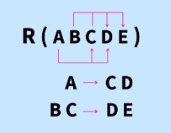
Diagrammatic Representation
Pointing arrows determines the depending attribute and the origin of the arrow determines the determinant set.

Slide 24


